Slide 1

Careertrail
A Job Portal

Slide 2
CONTENTS
Team Introduction
Data Flow Diagram Elements
Data Flow Diagrams
Entity Relationship Diagram
Conclusions

Slide 3


MEET OUR TEAM
Arijit Paul
Nabila Rahman
20200204067
20200204065

Slide 4
Data flow diagram elements
4
External Entities
Admin
Company
Job Seeker

Slide 5
Data flow diagram elements (cont.)
Processes
Sub Processes
Register and Logins
Applicant Profile
Listed Jobs
Applied Jobs
Create Forums
Show Forum Contents
Manage Company
Manage Jobs
Company’s Response
Create Forums
Show Topics
Comments
Show Questions and Answers
Count Compatibility Scores and Show CV
Company’s Response
Call For Interview Upon Compatibility Matching
Reject Applicant If No Match

Slide 6
Data flow diagram elements(cont.)
Data Stores
Job Seekers
Profiles
All Jobs
Job Apply
Forum Topic
Forum Comments
Admin Login
Company

Slide 7
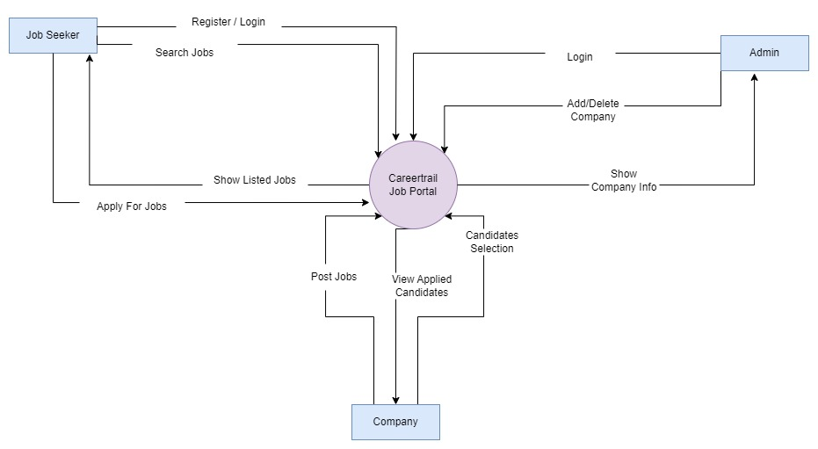
7
Level-0: Context Diagram

Slide 8
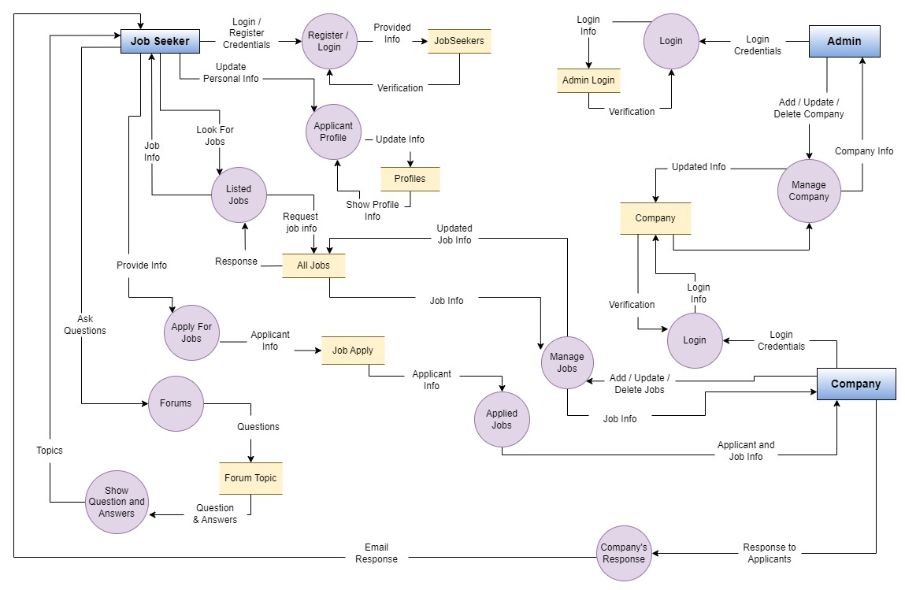
Level-1: Process Decomposition
8

Slide 9
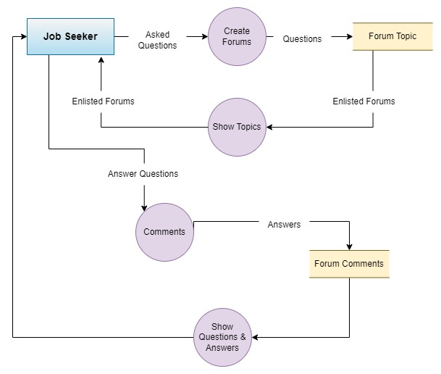
Level-2: Deeper Dives
(Forum Topics)
9
Topics and comments
Topics and comments

Slide 10
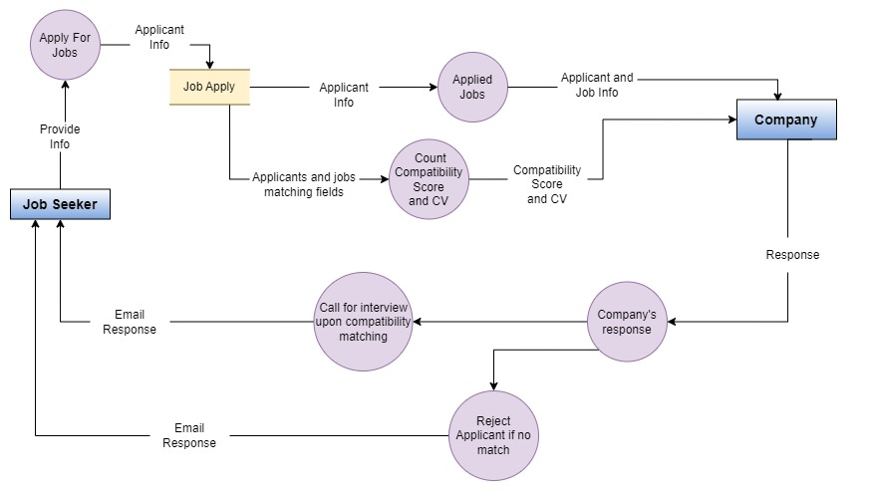
Level-2: Deeper Dives
(Candidate Selection Process)
10
Response
Response

Slide 11
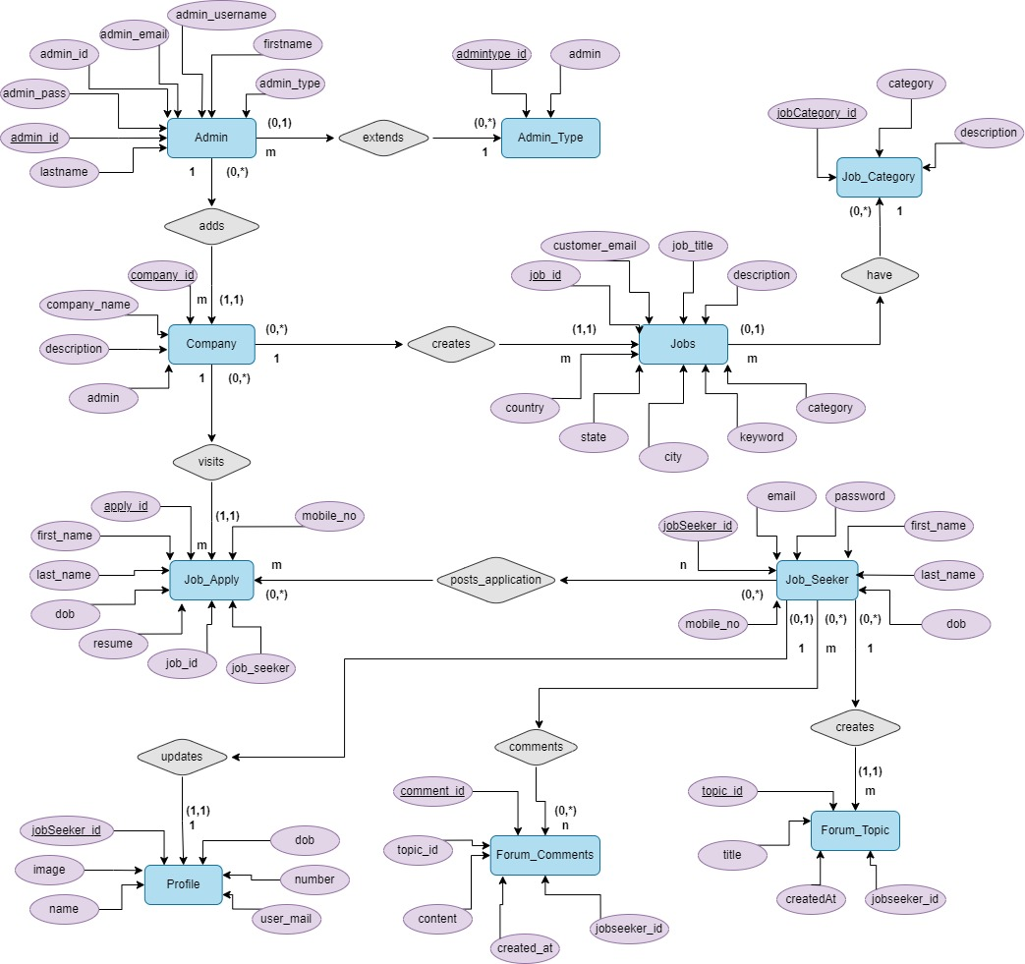
Entity relationship diagram
11

Slide 12
Thank you
12

